Slide 1
Defragment your hard drive with Defraggler

Slide 2
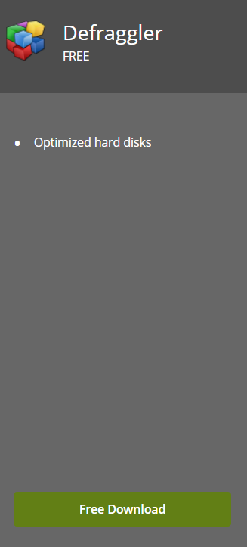

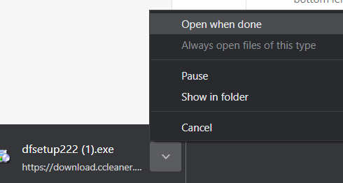
Download Defraggler
Go to this link: https://www.ccleaner.com/defraggler
Scroll down to the Defraggler downloads, and select “Free Download”
Then on the new page select the “Download” button
Install and open the Setup File

Slide 3
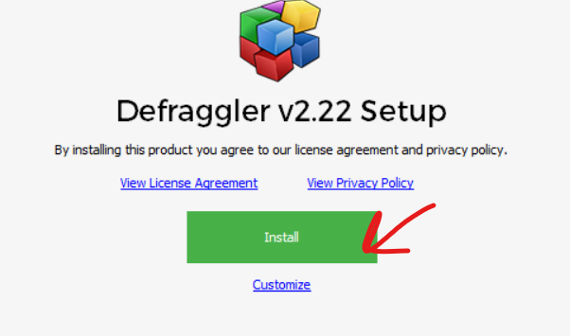
Install Defraggler
Go through the Defraggler setup by clicking “Install” on the newly opened app
Allow the installer to run, then reboot your computer when prompted (Make sure to save all your documents!), however you can opt to reboot later if you want.

Slide 4
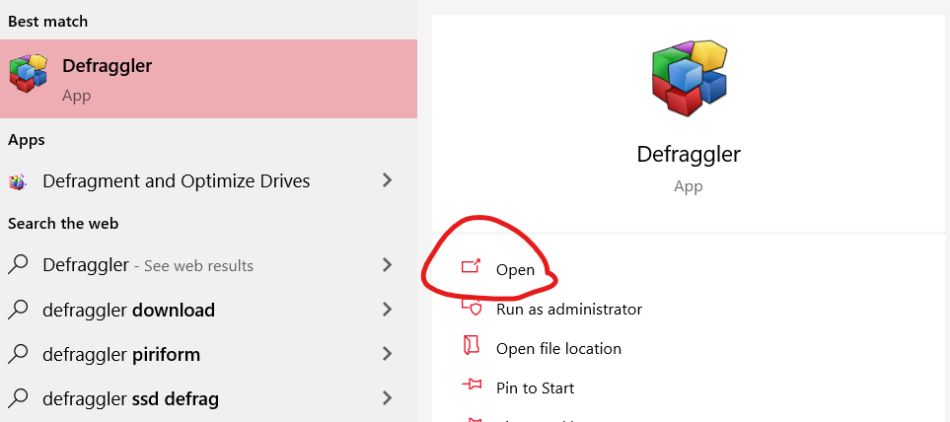
Open Defraggler
After rebooting your computer, go to the Windows search bar and type “Defraggler,” when it pops up, open the program

Slide 5
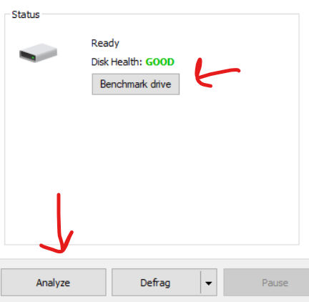
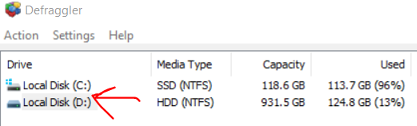

Analyze your drive
After opening Defraggler, select the drive you want to analyze in the top left, typically do the drive you use the most. If you only have one drive then you can ignore this.
Next, click the benchmark drive or the analyze button, either will work.
Allow the analyzer to run for a few moments
Side note: if your drive is an Solid State Drive (SSD), then you should not defragment it.
You can see your drive type under Media Type

Slide 6
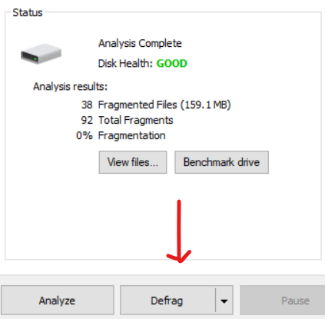
Run the defragmenter
After your drive has been analyzed, you will receive results based on your drives health and fragmentation
Next, you can click the Defrag button and the defragmenter will run.
Depending on how much fragmentation you have, this may take a while.
I recommend that if you have more than 10% fragmentation,
you should allow this to run during the night or the weekend.

Slide 7
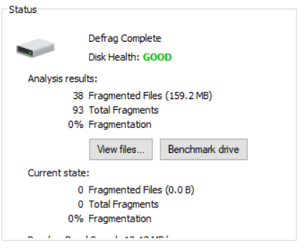
Completed
Once you are finished, you can see the current state of your drive in the status area.
You can now repeat the analyze and defragmenting process for any other hard drives you may use.
If your main drive is a Solid State Drive (SSD), then you should not defragment it.
You can see your drive type under Media Type

